Slide 1


PROJECT :- EDA FOR REAL STATE PRICING OF HOUSING DATA
Name:- AMAN SHARMA

Slide 2


Slide 3


Slide 4
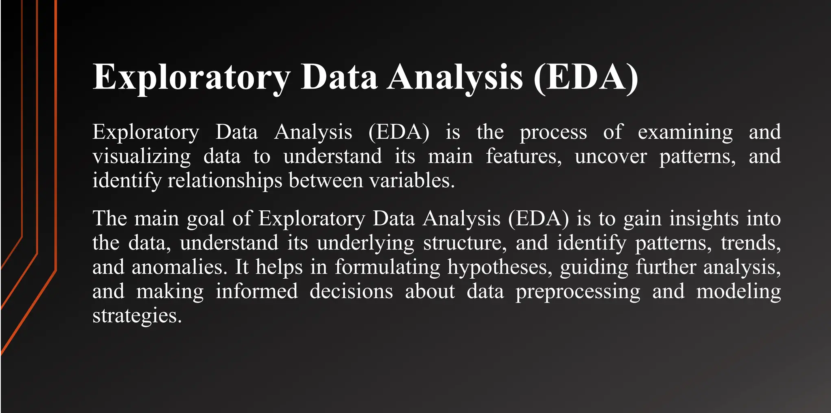

Slide 5
1. Feature Engineering and Size Impact
STEPS IN EDA FOR REAL ESTATE PRICING
1. Feature Engineering and Size Impact
Market Trends and Historical Pricing
Customer Preferences and Amenities
`
Engineer new features capturing relevant information such as price per square foot or the age of the property.
Visualize the relationship between key features like bedrooms, bathrooms, and square footage with house prices, determining their impact on valuation.
Explore the influence of customer preferences and amenities on house prices.
Utilize sentiment analysis on customer feedback to gauge the perceived value of specific features.
Analyze historical pricing trends over time, considering external factors like economic indicators.
Create time-series visualizations to understand how market trends influence house prices, helping predict future valuation trends.

Slide 6
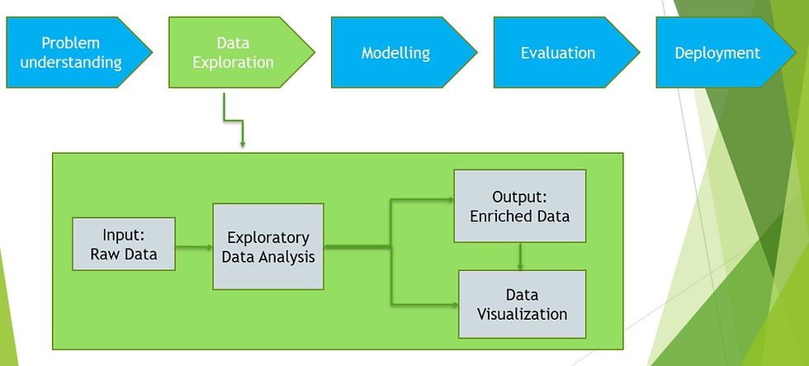

Slide 7
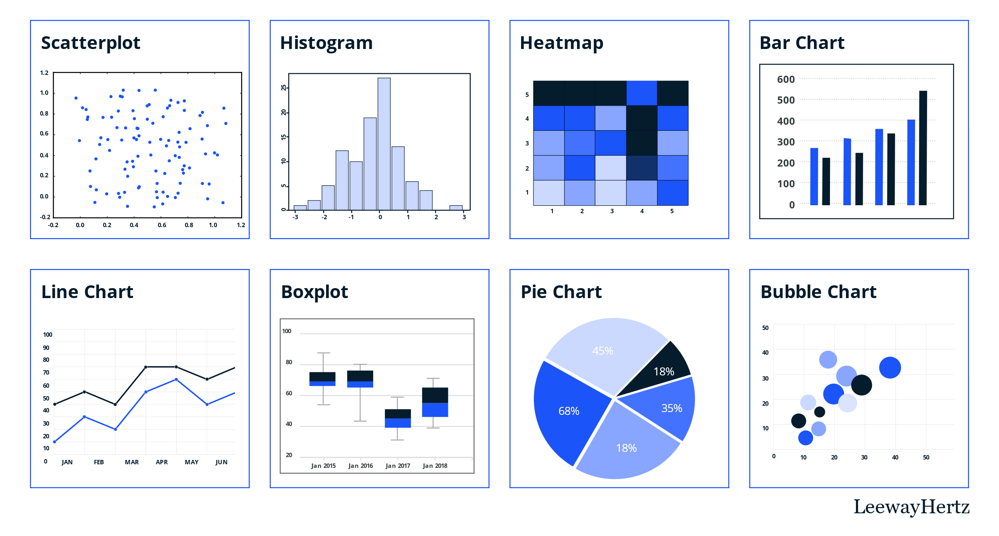

Slide 8
Visualization Techniques
A box plot is a graphical representation of statistical data based on the minimum, first quartile, median, third quartile, and maximum. Heatmap data visualization is a powerful tool used to represent numerical data graphically, where values are depicted using colors. This method is particularly effective for identifying patterns, trends, and anomalies within large datasets. A scatter chart shows the relationship between two different variables and it can reveal the distribution trends. A bar graph can be defined as a graphical representation of data, quantities, or numbers using bars or strips. They are used to compare and contrast different types of data, frequencies, or other measures of distinct categories of data.
BOX PLOT GRAPH
HEAT MAP GRAPH
SCATTER GRAPH
BAR GRAPH

Slide 9


Slide 10
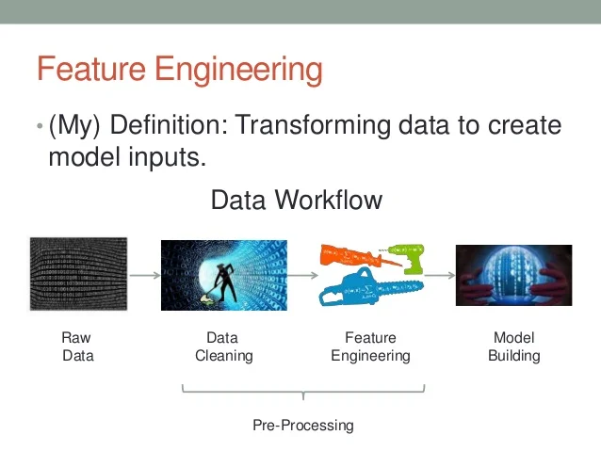

Slide 11
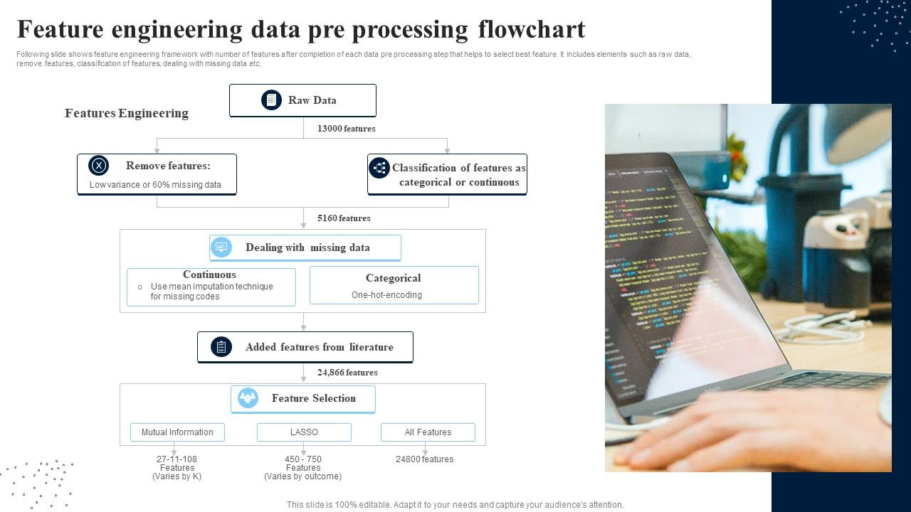

Slide 12
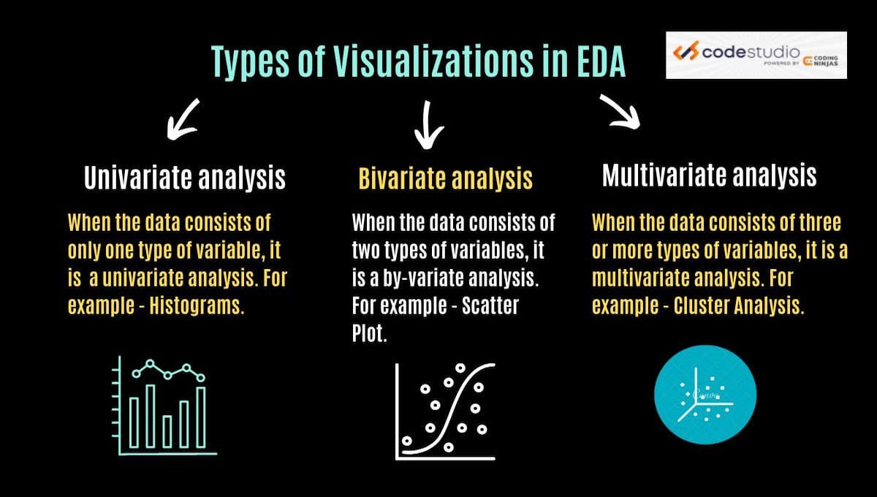

Slide 13
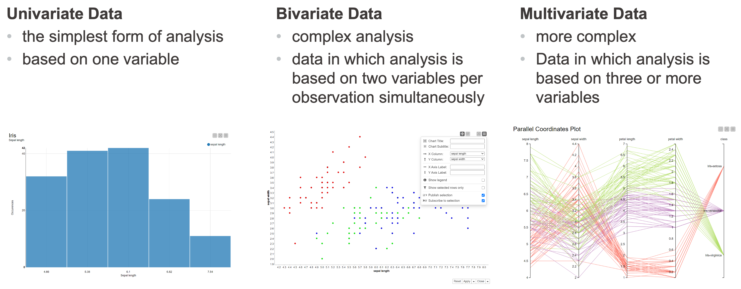

Slide 14
.
CONCLUSION !
In the comprehensive data preprocessing and exploration for the housing price prediction project, a systematic approach was employed. The initial steps involved the identification and handling of duplicate rows, along with the strategic treatment of missing values through either deletion or imputation based on the nature of the data. The quantitative features were meticulously examined for outlier identification and minimal treatment was carried out. Extensive EDA and visualization were performed, providing insights into the distribution of special numerical features. THANKS FOR NEXT HIKES IT SOLUTION FOR GIVEN THIS PROJECT

Slide 15
THANK YOU

